Slide 1
App
Development
The best marketing tool for your business.

Slide 2
Group Members
Jatin Singh
Ashish Jose
Himanshi Panwar
Akshay Mathew
Shubh Shubhankar
20BCE10019
20BCE10286
20BCE10247
20BCE10237
20BCE11025

Slide 3
Contents
Overview
Limitations
Proposed work and methodology
Hardware and Software
Objective
Architecture

Slide 4
PROJECT TITLE:
Project Guide:
SHOPEZY
Murugeshwari Mam

Slide 5
Overview
ShopEzy is an application which will help to boost local businesses around our homes.

Slide 6
Limitation
01
Cannot receive online orders.
The app will be built in electron js so its performance might get affected as it uses chrome v8 engine on some low end devices.
02

Slide 7
Proposed Work and Methodology:
Our first approach towards the project would be making a figma design of both the desktop screen application and the mobile application.
Then with the help of html /css/javascript we will make the complete front end of the desktop application.
Then we will use the softwares such as Electron js/node js to make our frontend design functional as a desktop application.

Slide 8
Proposed Work and Methodology:
In addition we will use a software naming P5js for showing the analytic graphs and visualisations of product statistics .
Now for the mobile scanning application we will be using android studio and its special features such as Google machine learning api.
Now talking about sharing of data between mobile and desktop application ,so for this we will create a http server with the help of node js software and with the help of this software and internet connection we can connect our desktop server app with the client mobile application.

Slide 10
Internet connectivity:​
We would need a local internet connection to share the information obtained from scanned barcode to the desktop software so that the software can keep the record of the stocks available at the shop. Also it can perform its other activities based on the obtained information such as profit/loss analysis.​

Slide 11
Softwares:​
Figma : In this software we will perform UX/UI and prototype designing of our desktop application as well as our android application.​

Slide 12
Github Desktop:​
We will use this software to share the project among our team members and also for the maintenance of our software. Also we can make our project open source through which we can receive suggestions from people world wide to make our software better.​

Slide 13
Hypertext Markup language(HTML):​
The HyperText Markup Language, or HTML is the standard markup language for documents designed to be displayed in a web browser.​
With the help of this we will display all the information to be displayed on the desktop application.​

Slide 14
css
Cascading Style Sheets (CSS) is used to format the layout of a webpage. With CSS, you can control the color, font, the size of text, the spacing between elements, how elements are positioned and laid out, what background images or background colors are to be used, different displays for different devices and screen sizes, and much more!
With the help of this software we will enhance the layouts of the data that is to be displayed on the desktop application.

Slide 15
JAVASCRIPT
ELECTRON JS
We will use this programming language to do all our programming works related to our desktop application.
We will use this software to run the designed frontend as a desktop software.

Slide 16
NODE JS:
This software will be used to support electron js with few of its special features.
Moreover we will make a http server with the help of Node Js to connect our desktop server application with our client mobile application

Slide 17
P5 JS:
ANDROID STUDIO:
We will use this software for making graphs and visualisations
We will use this software to develop our android mobile application.
The app will use google machine learning api which is available in this software for barcode scanning.

Slide 18
Novelty of the Project
Multilingual(English/Hindi) support for Local level Market.​
Easy to maintain the stocks.​
Provides the better analysis of sales for each products.​
Invoice, the smart way.​
Minimize the Losses of Store.​
Easy accessible by any Android phone. No extra device needed. ​

Slide 19
Real-Time Usage​
Automates Invoice production.​
Manages the stock.​
Checks the availability of Items.​
Gives the analysis of profit/loss of each products.​
Estimates Sales per month.​

Slide 20
Objective :
To help the shopkeepers to maintain their stocks easily.
To provide ease to shopkeepers by allowing them to use the software in their own local language i.e Hindi.
To promote their business by providing them the exact data of their profits or losses.

Slide 21
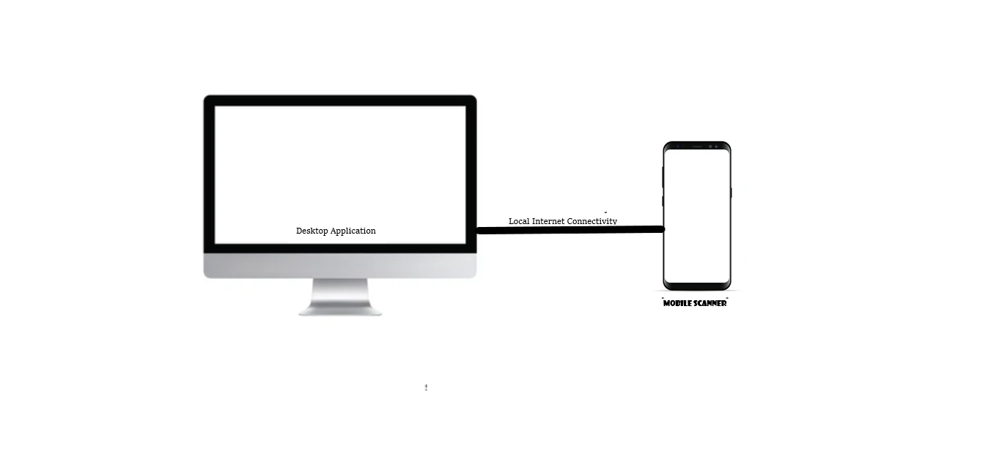
Overall Architecture And Flow Diagram:

Slide 22
The image in the previous slide shows the connection between the mobile phone and the desktop application of our project.
With the help of mobile we will scan the barcodes and the information of the product will be sent to the desktop application with the help of local internet connection.

Slide 23
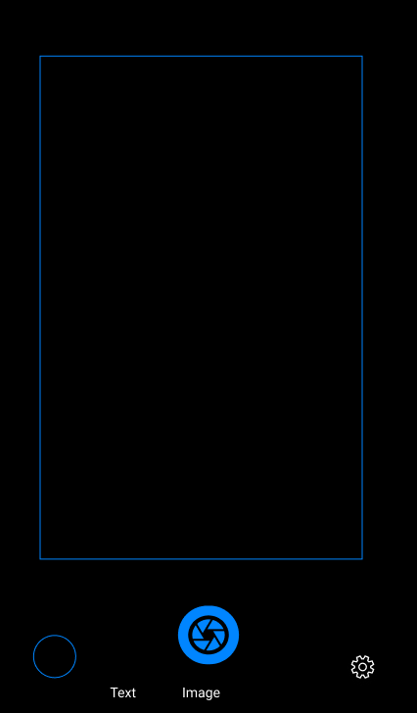
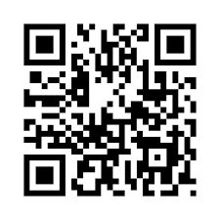

Slide 24
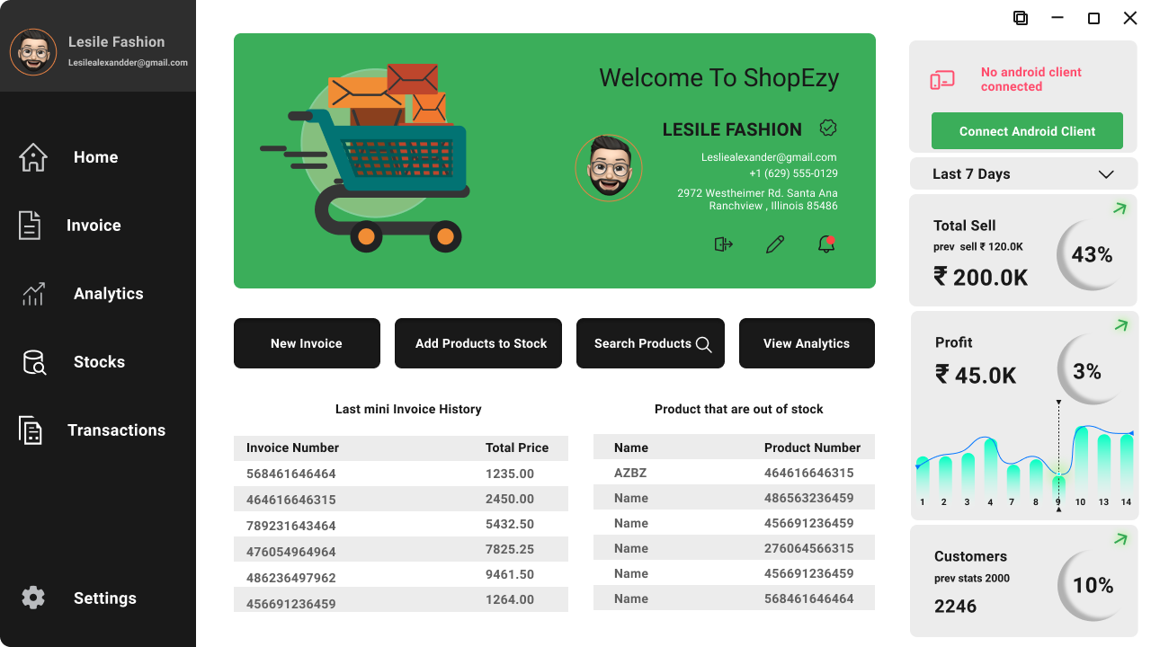

Slide 25
Complete Module Split up with the help of
Circle Diagram:
04
Design
Performance Improvement
01
03
Development
Feedback from Clients
02

Slide 26

Thank you !

